Slide 1

CAR PRICE PREDICTION using Machine Learning
By- SHALINI ROY
Internship Batch No- 32

Slide 2

Introduction
Used car sales are rising across the globe as a result of rising new automobile prices and consumers' inability to afford them. The current system involves a procedure where a vendor chooses a price at random and the buyer is unaware of the car and its current market value. In actuality, the seller is also ignorant of the car's current value or the appropriate selling price.

Slide 3
Problem Statement
With the covid 19 impact in the market, we have seen lot of changes in the car market. Now some cars are in demand hence making them costly and some are not in demand hence cheaper. One of our clients works with small traders, who sell used cars. With the change in market due to covid 19 impact, our client is facing problems with their previous car price valuation machine learning models. So, they are looking for new machine learning models from new data. We have to make car price valuation model. This project contains two phase:
Data Collection Phase: In this section, we need to scrape the data of used cars from websites (Olx, cardekho, Cars24 etc.)
Model Building Phase: After collecting the data, need to build a machine learning model.

Slide 4
Data Sources and their formats
This dataset contain 5466 rows and 26 columns.
Our target feature is Price_Rs.
Most of the features are categorical.

Slide 5
Data Pre-processing
Null value is present, need to impute this (All of the Categorical variable can be imputate with mode. All of the Numerical value can be imputate with Mean and Median. We can decide imputation method based on boxplot & Distplot.)
Seems outliers are present as there is a difference between 75% and max of some features.
Minimum Engine_displacement is 0. Seems it is a error,
Minimum Length_mm is 4 where maximim 5453.
Minimum Car_age is 0 where maximum is 20 years.
Maximum Color of car is White.
In maximum cases Max_Torque of car is 200Nm@1750rpm.
In maximum cases Engine_Type is In-Line Engine

Slide 6
Exploratory Data Analysis (EDA)
Let’s start the observation exploration of feature analysis.

Slide 7
Project Flow Tasks Perform
Check the presence of duplicate or any data error.
Missing values present in data set.
Imputation of missing value with mean, median or mode is performed.
Feature Engineering for extraction of few new features out of existing features.
Feature selection
Label Encoding of Categorical features
Splitting of dataset into input & target feature
Standard Scaling of data
Finding Final model with respect to best Accuracy Score, CV Score.

Slide 8
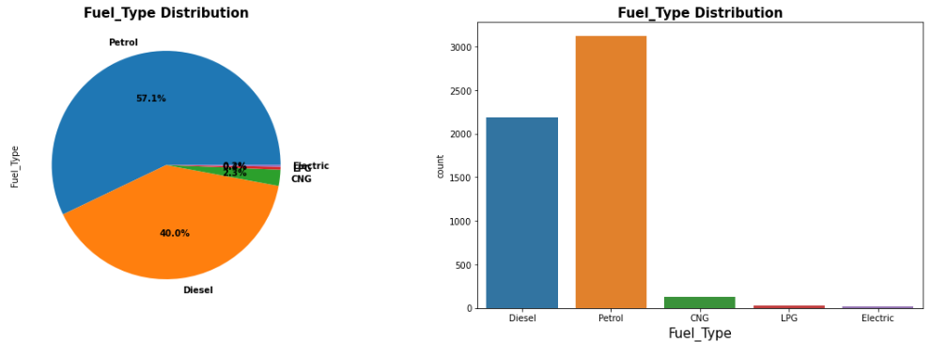
Different feature’s data Distribution
Observations:
Maximum Fuel type is Petrol which is 57 %.
Minimum Fuel type is Electric.
Maximum price is for Petrol and LPG car is the least
price car.

Slide 9
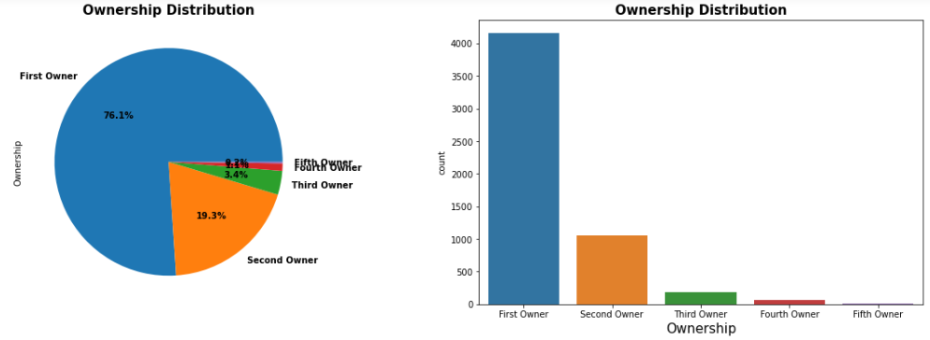
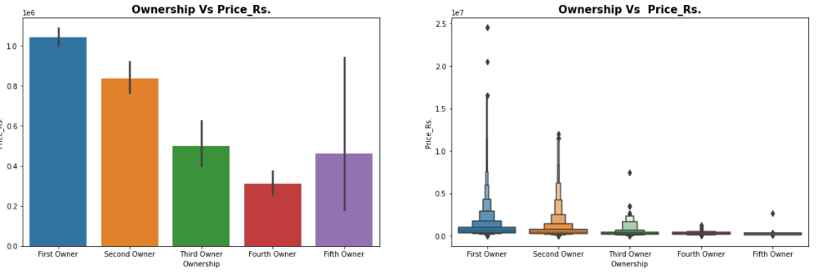
Observations:
Maximum ownership is First owner around 76%.
Minimum is fifth owner.
Car from first owner is high price.

Slide 10
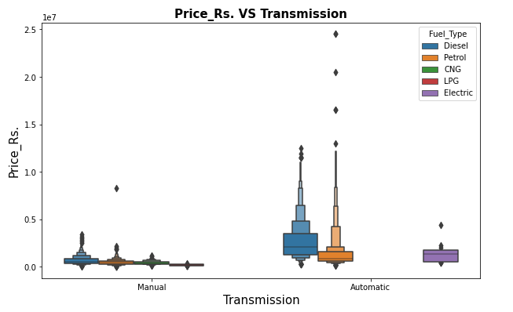
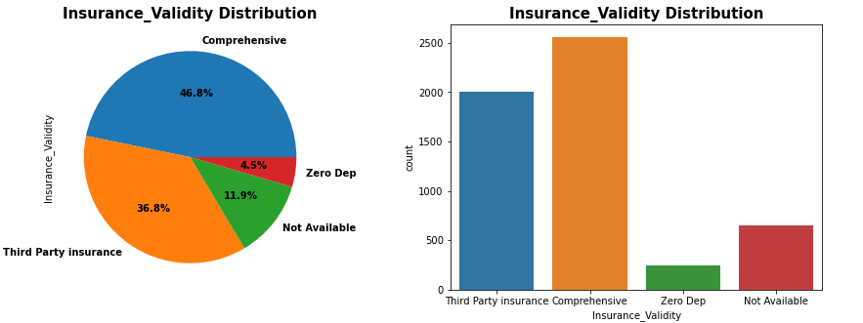
1. There are two Transmission type, Manual and Automatic. 2. Maximim transmission is Manual. 3. The pricing is high if the Transmission is Automatic 4. Maximim Insurance_Validity is Comprehensive which is 2055. 5. No such relationship between Insurance_Validity and corrosponding price.

Slide 11
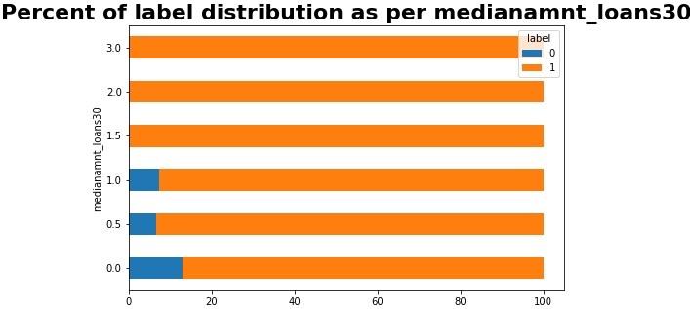
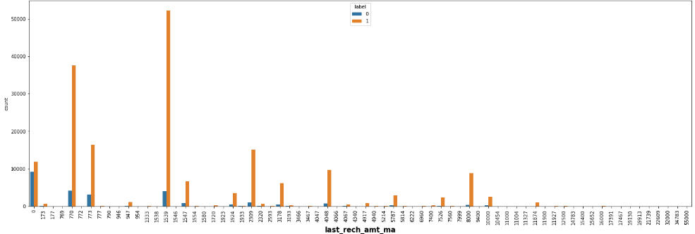

Slide 12
Observations:
Maximum medianamnt_loans30 that is Median of amounts of loan taken by the user in last 30 days is 0.0.
No defaulter for medianamnt_loans30 equal to 1.5, 2.0, 3.0
Maximum medianamnt_loans90 that is Median of amounts of loan taken by the user in last 90 days is 0.0.
No defaulter for medianamnt_loans90 equal to 1.5, 2.0, 3.0
Amount of last recharge of main account is maximum for 770, 1539.
Max defaulter are from last_rech_amt_ma=0.

Slide 13
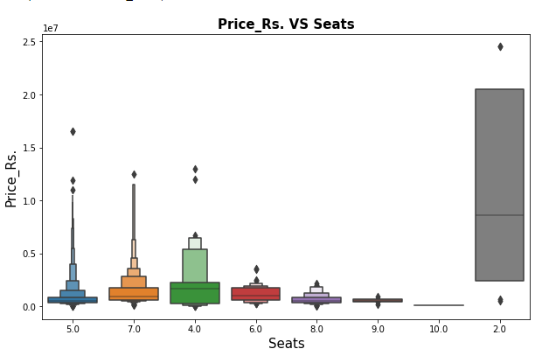
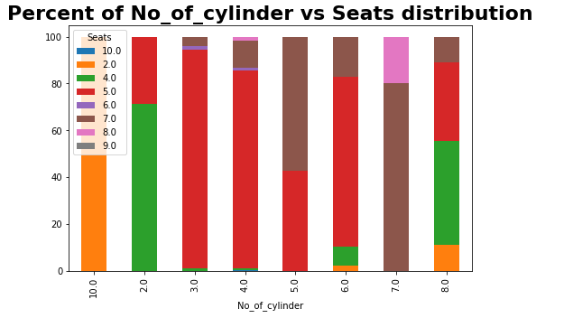

Slide 14
Observations:
Around 85% car is 5 seater.
Very few cars are 9 or 10 seater.
Among all 7 cars are 2 seater and they are very high in price.
Price is very less for 9 and 10 seated car
No of cylinder of maximum car is 4 followed by 3,
Car price is high for 8 and 10 cylinder.

Slide 15
Some more observations:
Maximim Turbo_charger type is No.
Only 2 are Twin type and their price is high.
Maximum Front_Brake_Type is Disc and Ventilated Disc.
Minimum type is Dual Circuit with ABS, ABS with BAS, Vacuum assisted hydraulic dual circuit w, Single Piston Sliding Caliper, Vented Disc.
The car price is high if Front_Brake_Type is Six piston claipers.
Maximum car are Power Steering_Type and it's price is also high compare to other steering types.
Hydraulic Steering_Type is most rare.

Slide 16
Continue…
The car price is low if the Steering_Type is Hydraulic or Manual.
Maximum tyre is Tubeless_Radial and it's price is low.
Tubeless_ Runflat is the most rare type and it is the cosier tyre compare to other types.
For maximum case, car age is 5 followed by 4.
Car price is high for 1 and 2 year old car.
The car price is very low if the age of the car is above 12 years.
Maximum milage is around 20 (range is 10 to 30)
Most of the cases the price is high if the torque is high value.

Slide 17
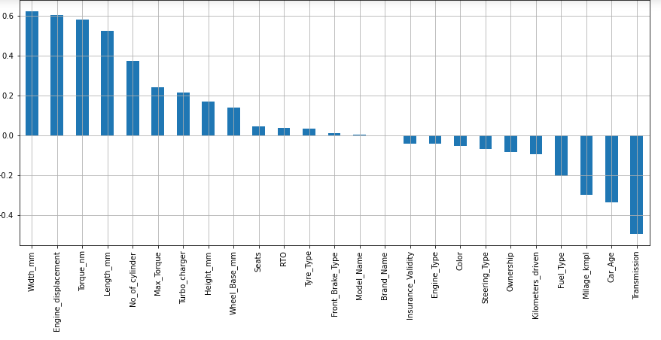
Correlation:
Brand_Name and Model_Name is very less correlated with target variable.
Maximum correlation observe in Width and Engine_displacement followed by torque & length.
Most of features are moderately & poorly correlated with each other.

Slide 18
Machine Learning Model Building

Slide 19
Machine Learning Algorithm Used
The different regression algorithm used in this project to build ML model are as below:
Linear Regression
DecisionTree Regressor
KNeighbors Regressor
GradientBoosting Regressor
RandomForest Regressor
Support Vector Regression
AdaBoost Regressor

Slide 20
ML Model Building Flow
Standard Scaling of Data
Splitting Training Data Using test_train_split
Finding Best Random state
Training ML Model on Different Algorithms
Hyper Parameter Tuning of every model
Apply 5 Fold Cross Validation with every different Model
Selection of Best Model Based on Evaluation Criteria
Saving final Model
Find best contributed feature among all of the features.
Predicating Test Dataset using Final Model

Slide 21
Key Findings and Conclusions of the Study
As car model get old eventually its price reduces with time.
In terms of Avg. Price as number of cylinders increases the average price increases.
Electric cars are a very tiny market and also relatively expensive when compared to gasoline-powered vehicles.
More than 50 % of car users prefer Power steering compares to others.
Most cars with manual steering are at least ten years old.

Slide 22
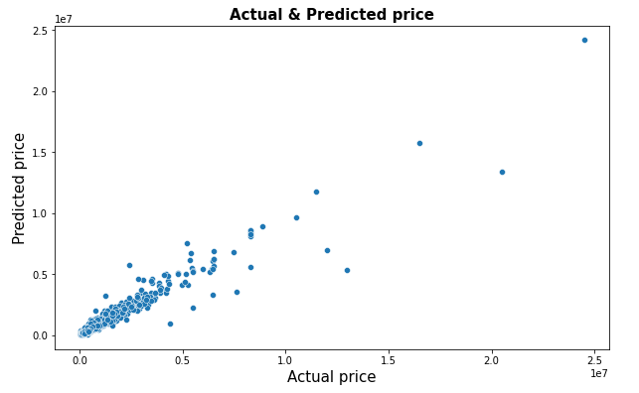
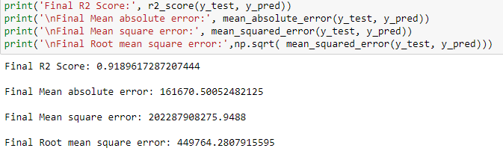
Conclusion:
Here Gradient Boosting Regressor giving maximum R2 Score, minimum RMSE Value, Maximum CV Score and minimum Standard Deviation. So Gradient Boosting Regressor is selected as best model. Here we can see the actual Vs Predicted data of this used car details dataset.
Final score is shown in the below picture.

Slide 23
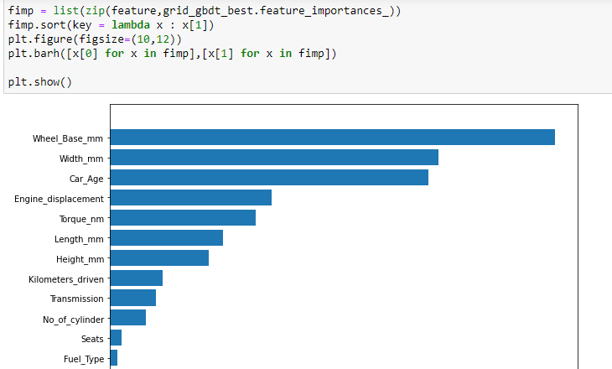
Check the important feature:
Wheel base, width are the most important feature for predicting price.
Interestingly Brand name, model name, steering type is the less importance feature.

Slide 24
Limitations of this work and Scope for Future Work
R2 score can increase with hyper parameter tuning with several different parameter. As it takes a lot of time, I am not able to use lot of parameters here for tuning.
We can scrape more information from many internet marketplaces like olx and car24. Clearly, more information leads to more accurate forecasting.
Data needs to be much precise and detailed for much better score.

Slide 25


